Slide 1
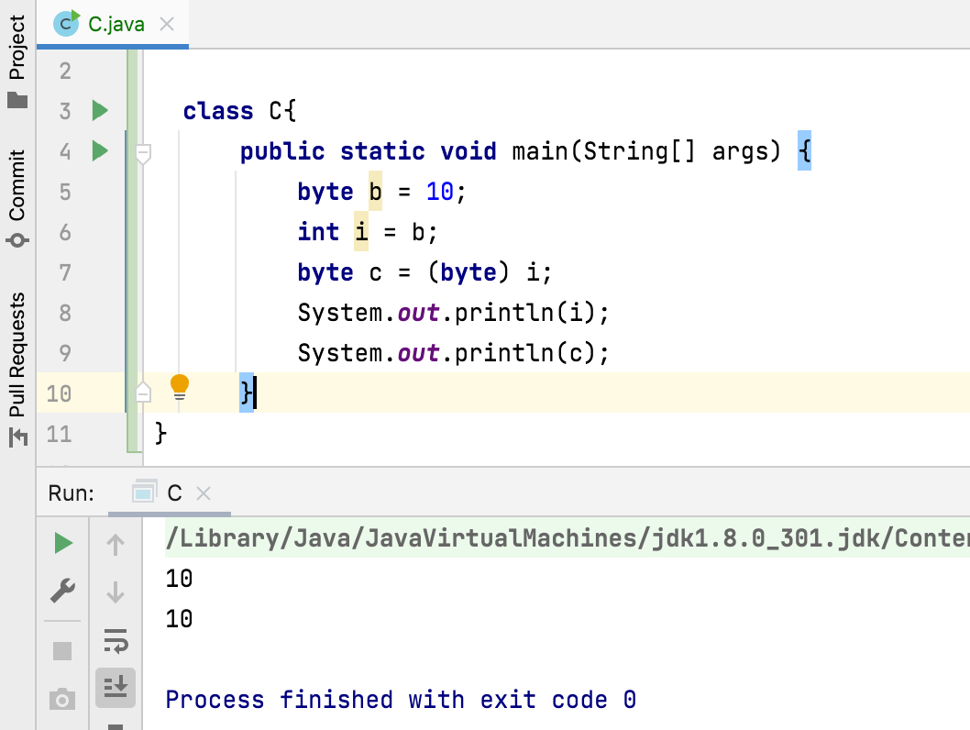
What is Type casting in java?
The Process of converting data from one data type to another data type.
Here, only type of the data can be changed but not the data itself.

